Slide 1











MEDICAL DATA HISTORY ANALYSIS
MY SQL PROJECT
By Suhana Shaikh

Slide 2

OBJECTIVE
ENHANCE PATIENT CARE
Utilize SQL to analyze patient data to identify trends and patterns that improve personalized treatment plans and healthcare outcomes.
OPTIMIZE OPERATIONS
Leverage data insights to improve resource allocation and operational efficiency, supporting informed decision-making and fostering business growth within the healthcare organization.

Slide 3
DATABASE SCHEMA DIAGRAM

Slide 4
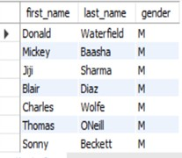
Q1 SHOW FIRST NAME, LAST NAME, AND GENDER OF PATIENTS WHO'S GENDER IS 'M'.
select first_name,last_name,gender from patients where gender= 'M';

Slide 5

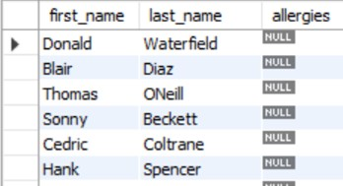








Q2 SHOW FIRST NAME AND LAST NAME OF PATIENTS WHO DOES NOT HAVE ALLERGIES.
select first_name,last_name,allergies from patients where allergies is null;

Slide 6
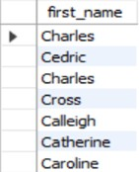






Q3 SHOW FIRST NAME OF PATIENTS THAT START WITH THE LETTER 'C'.
select first_name from patients where first_name like "C%";

Slide 7
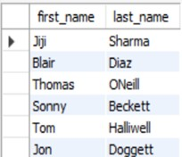
Q4 SHOW FIRST NAME AND LAST NAME OF PATIENTS THAT WEIGHT WITHIN THE RANGE OF 100 TO 120 (INCLUSIVE)
select first_name,last_name,weight from patients where weight between '100' and '120';

Slide 8
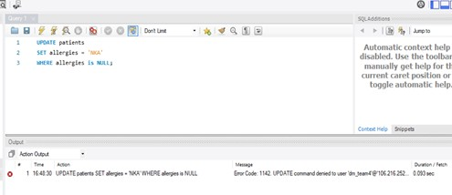

Q5 UPDATE THE PATIENTS TABLE FOR THE ALLERGIES COLUMN. IF THE PATIENT'S ALLERGIES IS NULL THEN REPLACE IT WITH 'NKA'.
update patients
set allergies = 'NKA' where allergies is NULL;

Slide 9

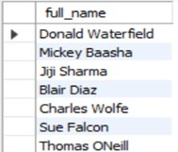


Q6 SHOW FIRST NAME AND LAST NAME CONCATENATED INTO ONE COLUMN TO SHOW THEIR FULL NAME.
select concat(first_name," ",last_name) as full_name
from patients;

Slide 10

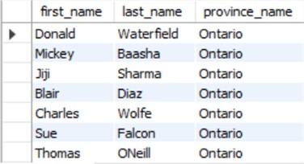

Q7 SHOW FIRST NAME, LAST NAME, AND THE FULL PROVINCE NAME OF EACH PATIENT.
select first_name,last_name,province_name from patients
join province_names
on patients.province_id = province_names.province_id;

Slide 11

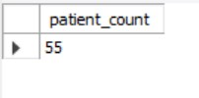
Q8 SHOW HOW MANY PATIENTS HAVE A BIRTH_DATE WITH 2010 AS THE BIRTH YEAR.
select count(*) as total_patients from patients
where year(birth_date) = '2010';

Slide 12


Q9 SHOW THE FIRST_NAME, LAST_NAME, AND HEIGHT OF THE PATIENT WITH THE GREATEST HEIGHT.
select first_name,last_name,height from patients
where height = (select max(height) from patients);

Slide 13

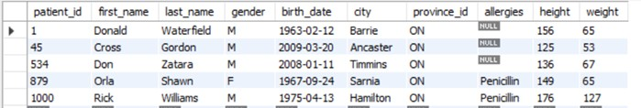
Q10 SHOW ALL COLUMNS FOR PATIENTS WHO HAVE ONE OF THE FOLLOWING PATIENT_IDS: 1,45,534,879,1000
select * from patients
where patient_id in (1,45,534,879,1000);

Slide 14


Q11 SHOW THE TOTAL NUMBER OF ADMISSIONS.
select count(*) as total_admissions from admissions;

Slide 15
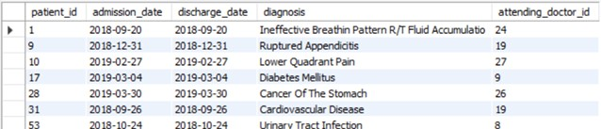
Q12 SHOW ALL THE COLUMNS FROM ADMISSIONS WHERE THE PATIENT WAS ADMITTED AND DISCHARGED ON THE SAME DAY.
select * from admissions
where admission_date = discharge_date;

Slide 16


Q13 SHOW THE TOTAL NUMBER OF ADMISSIONS FOR PATIENT_ID 579.
select patient_id,count(patient_id) as total_admissions
from admissions where patient_id = 579;

Slide 17
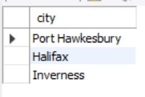

Q14 BASED ON THE CITIES THAT OUR PATIENTS LIVE IN, SHOW UNIQUE CITIES THAT ARE IN PROVINCE_ID 'NS'?
select distinct city from patients where province_id = 'NS';

Slide 18
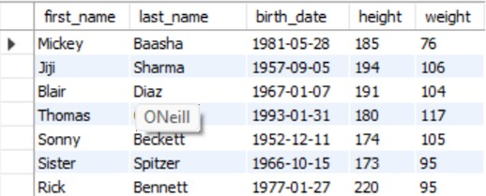
Q15 WRITE A QUERY TO FIND THE FIRST_NAME, LAST NAME AND BIRTH DATE OF PATIENTS WHO HAVE HEIGHT MORE THAN 160 AND WEIGHT MORE THAN 70
select first_name,last_name,birth_date,height,weight FROM patients
WHERE height > 160 AND weight > 70;

Slide 19
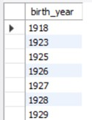
Q16 SHOW UNIQUE BIRTH YEARS FROM PATIENTS AND ORDER THEM BY ASCENDING.
select distinct year(birth_date) AS birth_year FROM patients
order by birth_year;

Slide 20
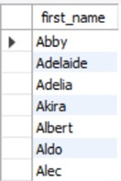

Q17 SHOW UNIQUE FIRST NAMES FROM THE PATIENTS TABLE WHICH ONLY OCCURS ONCE IN THE LIST.
select first_name from patients group by first_name
having COUNT(first_name) = 1;

Slide 21

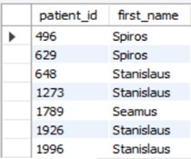





Q18 SHOW PATIENT_ID AND FIRST_NAME FROM PATIENTS WHERE THEIR FIRST_NAME START AND ENDS WITH 'S' AND IS AT LEAST 6 CHARACTERS LONG
select patient_id, first_name from patients
where first_name like 's %s';

Slide 22
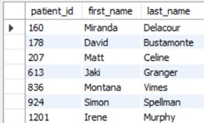
Q19 SHOW PATIENT_ID, FIRST_NAME, LAST_NAME FROM PATIENTS WHOS DIAGNOSIS IS 'DEMENTIA'. PRIMARY DIAGNOSIS IS STORED IN THE ADMISSIONS TABLE.
select p.patient_id, p.first_name, p.last_name from patients p
join admissions a on p.patient_id = a.patient_id where diagnosis = 'Dementia';

Slide 23
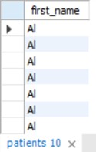

Q20 DISPLAY EVERY PATIENT'S FIRST_NAME. ORDER THE LIST BY THE LENGTH OF EACH NAME AND THEN BY ALPHBETICALLY.
select first_name from patients
order by length(first_name), first_name;

Slide 24


Q21 SHOW THE TOTAL AMOUNT OF MALE PATIENTS AND THE TOTAL AMOUNT OF FEMALE PATIENTS IN THE PATIENTS TABLE. DISPLAY THE TWO RESULTS IN THE SAME ROW.
select sum(gender = 'M') as male_count, sum(gender = 'F') as female_count from patients;

Slide 25

Q22 SHOW THE TOTAL AMOUNT OF MALE PATIENTS AND THE TOTAL AMOUNT OF FEMALE PATIENTS IN THE PATIENTS TABLE. DISPLAY THE TWO RESULTS IN THE SAME ROW.
select sum(gender = 'M') as male_count, sum(gender = 'F') as female_count from patients;

Slide 26

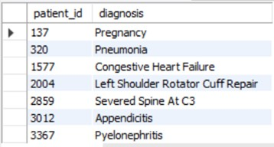
Q23 SHOW PATIENT_ID, DIAGNOSIS FROM ADMISSIONS. FIND PATIENTS ADMITTED MULTIPLE TIMES FOR THE SAME DIAGNOSIS.
select patient_id, diagnosis from admissions
group by patient_id, diagnosis having COUNT(diagnosis) > 1;

Slide 27
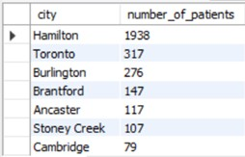

Q24 SHOW THE CITY AND THE TOTAL NUMBER OF PATIENTS IN THE CITY. ORDER FROM MOST TO LEAST PATIENTS AND THEN BY CITY NAME ASCENDING.
select city, COUNT(*) as number_of_patients from patients
group by city
order by number_of_patients desc, city asc;

Slide 28
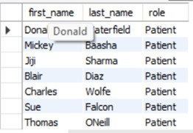

Q25 SHOW FIRST NAME, LAST NAME AND ROLE OF EVERY PERSON THAT IS EITHER PATIENT OR DOCTOR. THE ROLES ARE EITHER "PATIENT" OR "DOCTOR".
select first_name, last_name, 'Patient' as role from patients
union all
select first_name, last_name, 'Doctor' as role from doctors;

Slide 29

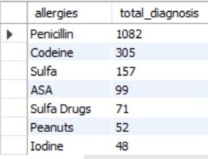
Q26 SHOW ALL ALLERGIES ORDERED BY POPULARITY. REMOVE NULL VALUES FROM QUERY.
select allergies, count(*) as total_diagnosis from patients
where allergies is not null group by allergies
order by total_diagnosis DESC;

Slide 30
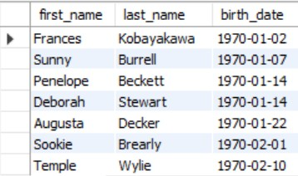
Q27 SHOW ALL PATIENT'S FIRST_NAME, LAST_NAME, AND BIRTH_DATE WHO WERE BORN IN THE 1970S DECADE. SORT THE LIST STARTING FROM THE EARLIEST BIRTH_DATE.
select first_name,last_name,birth_date from patients
where year(birth_date) between 1970 and 1979 order by birth_date ;

Slide 31
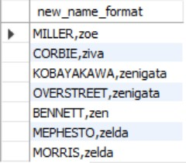
Q28 WE WANT TO DISPLAY EACH PATIENT'S FULL NAME IN A SINGLE COLUMN. THEIR LAST_NAME IN ALL UPPER LETTERS MUST APPEAR FIRST, THEN FIRST_NAME IN ALL LOWER CASE LETTERS. SEPARATE THE LAST_NAME AND FIRST_NAME WITH A COMMA. ORDER THE LIST BY THE FIRST_NAME IN DECENDING ORDER.
select concat(upper(last_name), ',', lower(first_name)) as new_name_format from patients
order by first_name desc;

Slide 32
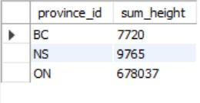







Q29 SHOW THE PROVINCE_ID(S), SUM OF HEIGHT; WHERE THE TOTAL SUM OF ITS PATIENT'S HEIGHT IS GREATER THAN OR EQUAL TO 7,000.
select pr.province_id, sum(pa.height) as sum_height from province_names pr
join patients pa on pr.province_id = pa.province_id group by pr.province_id
having sum(pa.height) >= 7000;

Slide 33





Q30 SHOW THE DIFFERENCE BETWEEN THE LARGEST WEIGHT AND SMALLEST WEIGHT FOR PATIENTS WITH THE LAST NAME 'MARONI'.
select (max(weight) - min(weight)) as weight_diff from patients
where last_name = 'Maroni';

Slide 34
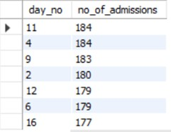
Q31 SHOW ALL OF THE DAYS OF THE MONTH (1-31) AND HOW MANY ADMISSION_DATES OCCURRED ON THAT DAY. SORT BY THE DAY WITH MOST ADMISSIONS TO LEAST ADMISSIONS.
select day(admission_date) as day_no, count(patient_id) as no_of_admissions from admissions
group by day_no
order by no_of_admissions desc;

Slide 35
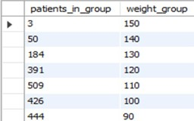
Q32 SHOW ALL OF THE PATIENTS GROUPED INTO WEIGHT GROUPS. SHOW THE TOTAL AMOUNT OF PATIENTS IN EACH WEIGHT GROUP. ORDER THE LIST BY THE WEIGHT GROUP DECENDING. E.G. IF THEY WEIGHT 100 TO 109 THEY ARE PLACED IN THE 100 WEIGHT GROUP, 110-119 = 110 WEIGHT GROUP, ETC.
select floor(weight / 10) * 10 as weight_group, count(*) as total_patients
from patients
group by weight_group order by weight_group desc;

Slide 36
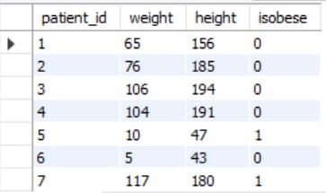
Q33 SHOW PATIENT_ID, WEIGHT, HEIGHT, ISOBESE FROM THE PATIENTS TABLE. DISPLAY ISOBESE AS A BOOLEAN 0 OR 1. OBESE IS DEFINED AS WEIGHT(KG)/(HEIGHT(M). WEIGHT IS IN UNITS KG. HEIGHT IS IN UNITS CM.
select patient_id,weight,height, case
when weight / power(height / 100.00, 2) >= 30
then 1
else 0
end as isobese from patients;

Slide 37

Q34 SHOW PATIENT_ID, FIRST_NAME, LAST_NAME, AND ATTENDING DOCTOR'S SPECIALTY. SHOW ONLY THE PATIENTS WHO HAS A DIAGNOSIS AS 'EPILEPSY' AND THE DOCTOR'S FIRST NAME IS 'LISA'. CHECK PATIENTS, ADMISSIONS, AND DOCTORS TABLES FOR REQUIRED INFORMATION.
select p.patient_id, p.first_name, p.last_name,d.specialty from patients p
inner join admissions a on p.patient_id = a.patient_id
inner join doctors d on a.attending_doctor_id = d.doctor_id where a.diagnosis = 'Epilepsy'and d.first_name = 'Lisa';

Slide 38
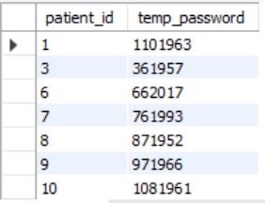


Q35 ALL PATIENTS WHO HAVE GONE THROUGH ADMISSIONS, CAN SEE THEIR MEDICAL DOCUMENTS ON OUR SITE. THOSE PATIENTS ARE GIVEN A TEMPORARY PASSWORD AFTER THEIR FIRST ADMISSION. SHOW THE PATIENT_ID AND TEMP_PASSWORD.
THE PASSWORD MUST BE THE FOLLOWING, IN ORDER:
PATIENT_ID
THE NUMERICAL LENGTH OF PATIENT'S LAST_NAME
YEAR OF PATIENT'S BIRTH_DATE
select distinct p.patient_id, concat(a.patient_id, length(p.last_name), year(p.birth_date)) as temp_password from patients p
inner join admissions a on p.patient_id = a.patient_id;

Slide 39


THANK YOU
https://www.linkedin.com/in/suhana-shaikh-936202290
suhanashaikh782@gmail.com
https://github.com/Suhana579

